Slide 1
Adapting to North Carolina's Changing Climate
Part 2: Climate Change Program

Slide 2
Adaptation
Refers to actions taken at the individual, local, regional, and national levels to reduce risks from even today’s changed climate conditions and to prepare for impacts from additional changes projected for the future.
Addresses two timescales:
adapting to current variability, which in any particular location may now be different than suggested by the historical record of climate observations, and
preparing for future change
4th National Climate Assessment, Chapter 28: https://nca2018.globalchange.gov/chapter/28/

Slide 3
Resilience
Resilience refers to the ability of a system to recover from or adjust to misfortune or change.
More formally, resilience is the capacity of a community, business, or natural environment to prevent, withstand, respond to, and recover from a disruption.
Climate resilience refers to situations where the disruptions are related to climate or extreme weather.
https://toolkit.climate.gov/#steps

Slide 4
Warming Temperatures (esp.at night)
Key Observed Climate Changes in North Carolina
More Intense Precipitation
Sea Level Rise
(faster on northern NC coast)
NC Climate Science Report Plain Language Summary. NC Climate Risk Assessment and Resilience Plan

Slide 5
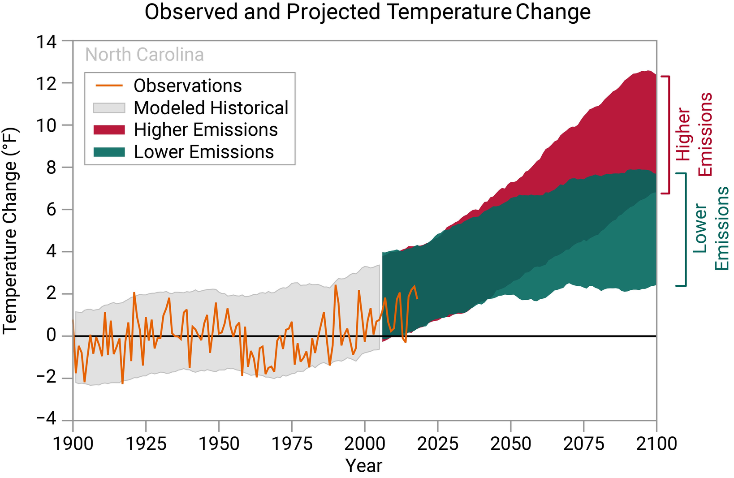
Warming Temperatures
North Carolina has warmed by about 1°F over the past 120 years.
Scientists expect the warming to continue in North Carolina through this century, in all seasons.
Annual average temperature increases relative to the recent climate (1996–2015) for North Carolina are projected to be on the order of 2°–5°F under the current emissions scenario and 2°–4°F under a lower emissions scenario by the middle of this century.
The amount of warming will depend on future emissions of heat-trapping gases.
National Climate Assessment State Climate Summaries
NC Climate Science Report Plain Language Summary
NC Climate Risk Assessment and Resilience Plan

Slide 6
In the future, both days and nights are likely to get hotter
Hotter Days
Warmer Nights
There is no historical trend in very hot days
It is likely that the number of hot and very hot days will increase in the future, consistent with the overall trend in warming.
This increased heat, together with increases in humidity, will present a public health risk.
The heat index is a measure that combines air temperature and relative humidity to get at how the human body experiences these conditions. It is very likely that there will be more days with dangerously high heat index values due to increases in temperature and humidity.
Nights have been getting warmer.
The last five years (2015–2019) have had the warmest overnight low temperatures on record in North Carolina, with 2019 setting the record for the warmest lows in the recorded past.
The number of very warm nights will very likely increase, reducing relief from the heat of the day and increasing heat-related stress on public health; households and people who lack access to sufficient cooling will be most vulnerable.
These warm nights affect public health and agriculture.
NC Climate Science Report Plain Language Summary
NC Climate Risk Assessment and Resilience Plan

Slide 7
In the future, both days and nights are likely to get hotter
Hotter Days
Warmer Nights
*The long-term (1900-2018) average is 9.9 very hot days per year
*The long-term (1900-2018) average is 4.6 very warm nights per year
NC Climate Science Report Plain Language Summary NC Climate Risk Assessment and Resilience Plan
Notes:
The long-term average is 9.9 very hot days per year for
1900–2018.
The long-term average is 4.6 very warm nights per year for
1900–2018.

Slide 8
Adapting to Changing Temperatures
As now, the climate, the season, and potential pests all affect the selection of what and when to plant.
Are you planting something that will live <1 to a few years? Consider current and recent climate information
The Home Garden
Are you planting something that will live for 10-50+ years? Consider future climate projections as well as how the landscape may change (e.g., is the area urbanizing or likely to become more urban?)

Slide 9
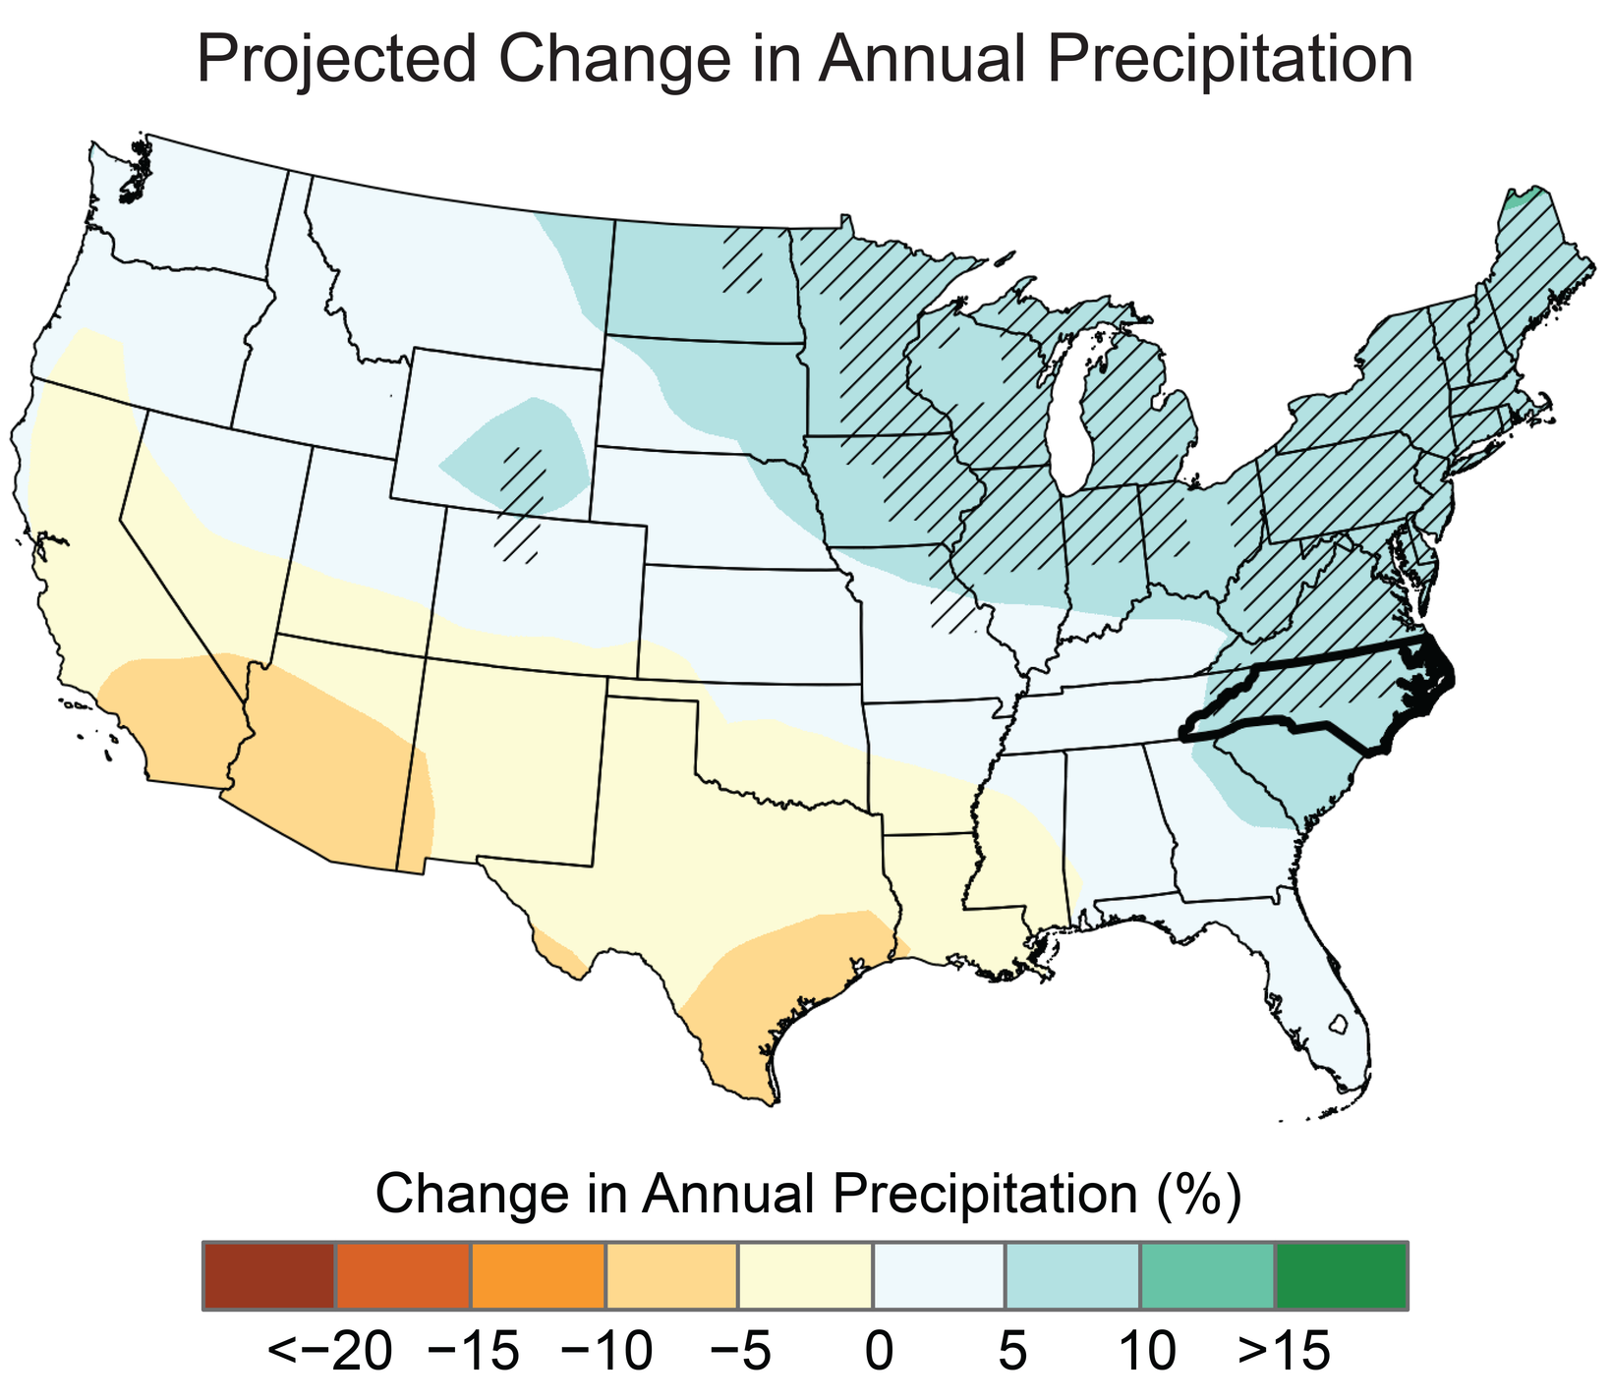
Annual and Extreme Rainfall
There is no historic trend in annual precipitation, but annual precipitation is projected to increase in the future.
Extreme rainfall has increased in the recent past, and in the future, heavy rains from hurricanes and other weather systems will become more frequent and more intense.
These changes are driven primarily by increases in atmospheric water vapor as the climate warms.
NC Climate Science Report Plain Language Summary
NC Climate Risk Assessment and Resilience Plan
National Climate Assessment State Climate Summaries
Notes:
Original caption for figure on slide: Projected changes in total annual precipitation (%) for the middle of the 21st century compared to the late 20th century under a higher emissions pathway. Hatching represents areas where the majority of climate models indicate a statistically significant change. North Carolina is on the southern end of a large area of projected increases in annual precipitation over the northeastern United States. Sources: CISESS and NEMAC. Data: CMIP5.

Slide 10
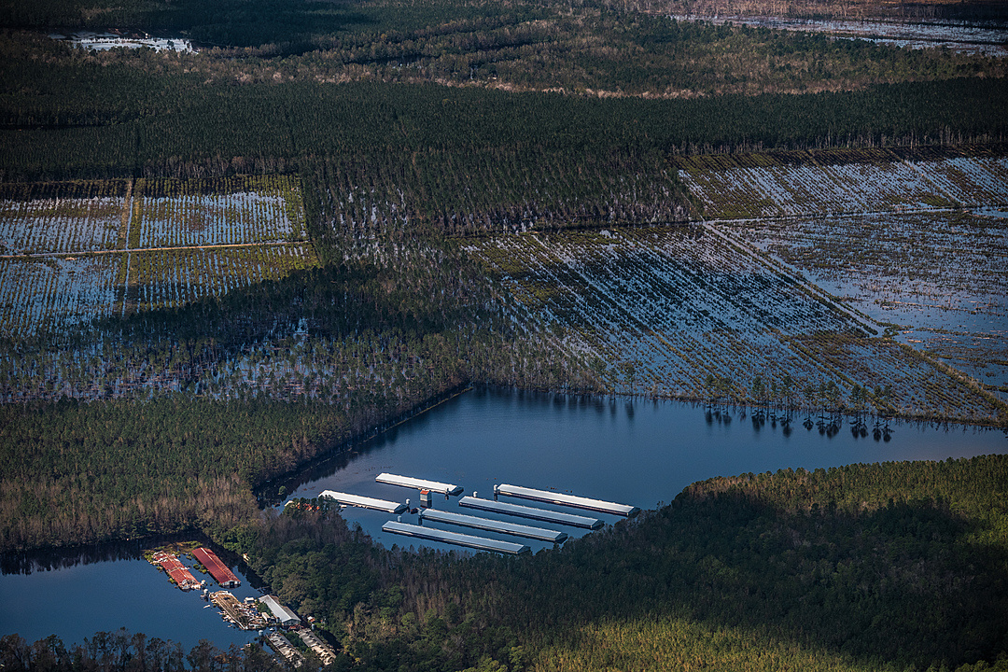
Heavy Precipitation
A warmer atmosphere contains more water vapor. A 1°F rise in temperature equals as much as a 4% increase in atmospheric water vapor
An atmosphere with more water vapor can make more precipitation
The biggest rainfall events are getting bigger, and extreme rain is comprising more of our annual precipitation
Aerial views of flooded farms in Duplin County, North Carolina following Hurricane Florence in 2018. Image Credit: Jo-Anne McArthur / We Animals Media
https://www.globalchange.gov/browse/indicator-details/3962
https://www.ncei.noaa.gov/news/warming-earth-also-wetter-earth

Slide 11
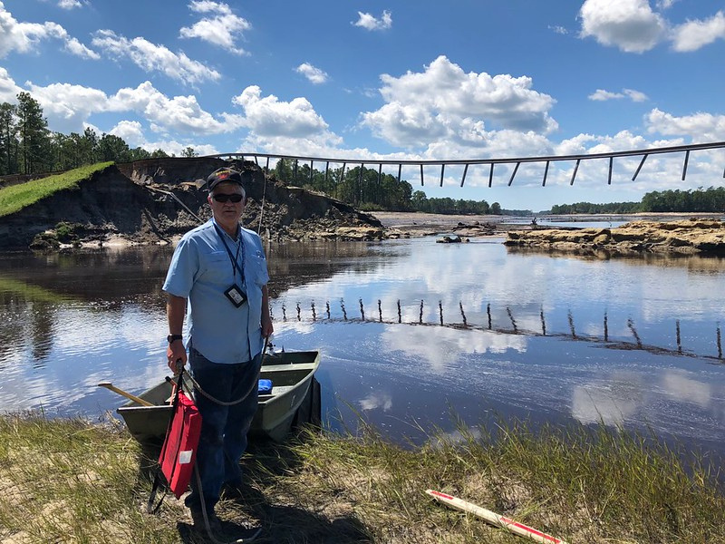
Hurricanes
Strongest storms are projected to become stronger
Likely that hurricanes in a warmer environment will produce heavier precipitation
Less consensus on how the frequency of hurricanes will change or what this means for US or NC landfalls
Ken Gray, Savannah District Construction Division Chief, prepares to enter a boat to inspect the washout of Boiling Springs Dam, N.C. Sept. 19 after Hurricane Florence. The object stretching across the divide is the guard rail of the road that once passed over the dam.
Source: US Army Corps of Engineers (CC by 2.0) https://flic.kr/p/2bcFnmm
NC Climate Science Report Plain Language Summary
4th National Climate Assessment, Chapter 2: Our Changing Climate

Slide 12
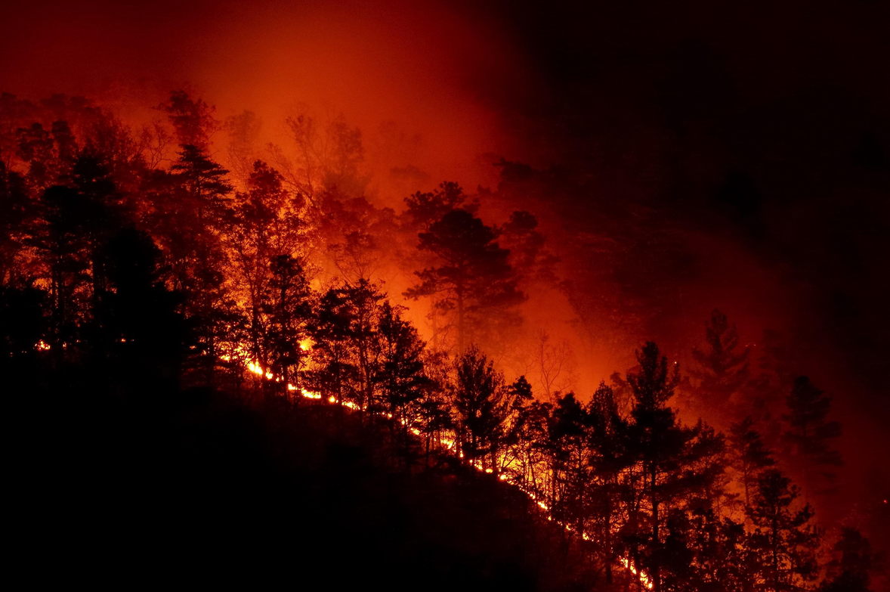
Droughts and Wildfires
Severe droughts will become more intense, and this will increase the risk of wildfires
It is likely that future severe droughts in North Carolina will be more intense.
Rising temperatures and the resulting increase in evaporation will accelerate the rate at which soils dry out. Thus, naturally occurring droughts in North Carolina will be more severe.
It is likely that future severe droughts in their multiple forms in North Carolina will be more frequent and intense due to higher temperatures leading to increased evaporation.
As a result, it is likely that the frequency of climate conditions conducive to wildfires in North Carolina will increase.
The Chestnut Knob Fire started on Sunday November 6, 2016 at 8:00 am in South Mountain State park 10 miles south of Morganton, NC, during an intense drought.
Image credit: NC Forest Service
NC Climate Science Report Plain Language Summary
NC Climate Risk Assessment and Resilience Plan

Slide 13
Consider the water needs of landscape and garden plants. How will these handle more frequent drying (droughts) associated with warming temperatures?
Adapting to Changing Precipitation
The combination of urbanization and more intense precipitation from climate change are exacerbating stream bank erosion.
Examine low-lying areas and areas prone to (flash) flooding. Can existing vegetation handle frequent inundation?
06
What inputs do you currently need to grow _______?
fertilizer?
water?
frost/freeze protection?
pesticide application?
How might these inputs grow or shrink under future climate change?
The Home Garden
Resources on gardening for stream repair and water quality:
https://content.ces.ncsu.edu/a-gardeners-guide-to-protecting-water-quality
https://content.ces.ncsu.edu/options-for-backyard-stream-repair

Slide 14
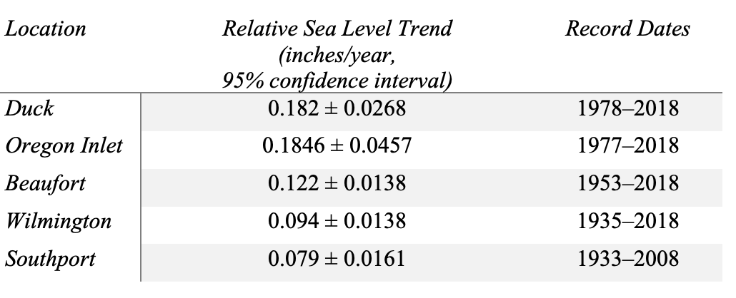
Sea Level Rise
Over recent decades, global average sea level risen ~2x as much from increasing ocean water as from thermal expansion
It is virtually certain that sea level along the North Carolina coast will continue to rise due to expansion of ocean water from warming and melting of ice on land.
It is also virtually certain that rising sea level and increasing intensity of coastal storms will lead to an increase in storm surge flooding in coastal North Carolina.
Many areas along NC’s coast projected to be impacted by high tide flooding on a near daily basis by 2100
Trend in relative sea level determined from long-term water level records in North Carolina.
North Carolina Climate Science Report, Chapter 4
NC Climate Risk Assessment and Resilience Plan

Slide 15
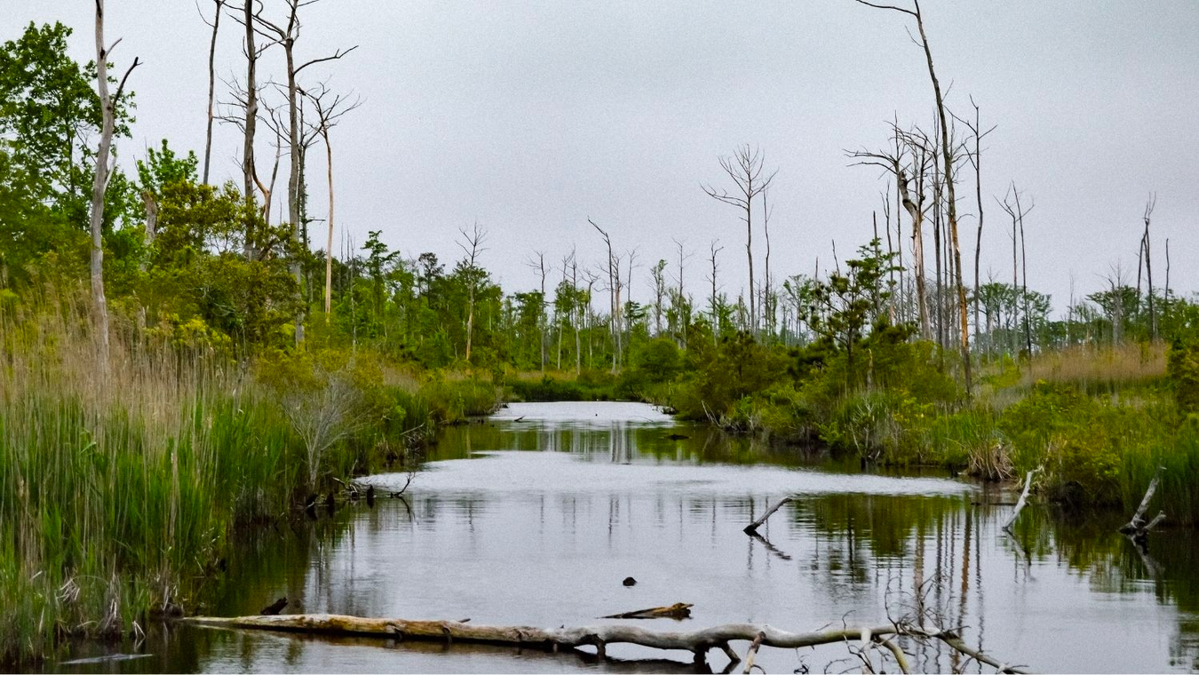
Sea Level Rise
Canals may serve as conduits for saltwater intrusion. Photo: NC State University news

Slide 16
Recap: Projected Climate Changes and Impacts in NC
Sea Level will continue to rise
Summer heat index values will increase
Annual total precipitation will increase
Virtually Certain
Very Likely
Likely
Hurricane intensity will increase
Severe droughts will become more intense
Increase in precipitation will lead to increase in inland flooding
Likely
Likely
Likely
Probability of Outcome Key
Virtually Certain = 99-100%
Very Likely = 90-100%
Likely = 66-100%
About as Likely as Not = 33-66%
Unlikely = 0-33%
Very Unlikely = 0-10%
Exceptionally Unlikely = 0-1%
NC Climate Science Report Plain Language Summary. NC Climate Risk Assessment and Resilience Plan

Slide 17
Group Brainstorming Activity
Name, where you're from, area of expertise or interest, and what brought you here today.
As a group, decide on a location (e.g., a garden, park, community center) and brainstorm the climate-related impacts it may face over the next few decades.
For each of the impacts your group identified, brainstorm how that impact could be reduced or eliminated through adaptation. What resources (e.g., time, money, people) will be needed?
GET TO KNOW YOUR GROUP
CATALOG IMPACTS
Introductions
THINK ABOUT CLIMATE RESILIENT ADAPTATIONS
Define the Problem
Brainstorm Solutions

Slide 18
Explore More:
Resilience Toolkits*
US Climate Resilience Toolkit
Georgetown Adaptation Clearninghouse
Climate Adaptation Knowledge Exchange
Learn about potential climate hazards, learn about building resilience, view resilience case studies, and explore climate data.
An online database and networking site that serves policymakers and others who are working to help communities adapt to climate change
Climate adaptation case studies and resources.
https://toolkit.climate.gov/
https://www.adaptationclearinghouse.org/
https://www.cakex.org/
*Most online toolkits and similar resources are aimed at local governments and city planners, rather than individuals

Slide 19
Reflection Activity
Explore the US Climate Resilience Toolkit case studies: https://toolkit.climate.gov/case-studies
Find one that is relevant or interesting to you and read it.
Afterwards, write down (or mentally reflect):
How did the five steps to resilience appear in this case study?
What is one thing you learned?
Can you apply anything from this case study to your area (e.g., your town/city? community?) What is it, and how would you apply it?

Slide 20
NC State Climate Office
climate.ncsu.edu
@ncsco
Thank you

